Slide 1



A Multi-User Terminology Mapping Toolbox
Sebastian MATE ^{a,}, Susanne A. SEUCHTER ª, Katharina EHRENBERG ª, Noemi DEPPENWIESE ^{b}, Jakob ZIERK ^{a,c}, Hans-Ulrich PROKOSCH ^{a,b}, Detlef KRASKA ª, and Lorenz A. KAPSNER ª
ª Medical Center for Information and Communication Technology, Universitätsklinikum Erlangen, Erlangen, Germany. ^{b} Chair of Medical Informatics, Friedrich-Alexander-Universität Erlangen-Nürnberg (FAU), Erlangen, Germany. ^{c} Department of Pediatrics and Adolescent Medicine, Universitätsklinikum Erlangen, Erlangen, Germany.
Notes:
Hello everybody! My name is Sebastian Mate. I‘m a computer scientist working for the MIRACUM data integration center at Universitätsklinikum Erlangen. In my talk I will report on a project, in which we implemented a multi-user terminology mapping toolbox that we have subsequently used to map about 10,000 local laboratory codes to LOINC. (0:22)

Slide 2
A Multi-User Terminology Mapping Toolbox
S Mate, SA Seuchter, K Ehrenberg, N Deppenwiese, J Zierk, H-U Prokosch, D Kraska, and LA Kapsner
TBD
The authors declare that they have no conflicting interests.
N/A
N/A

Slide 3
Introduction: Reuse of Data
Research based on secondary use of medical data may require the merging of such data from multiple sources
Several projects are now building research infrastructures for this task
Examples: OHDSI [1], SHRINE [2], PCORnet [3], …
In Germany: Medical Informatics Initiative (MII) [4]: SMITH, DIFUTURE, HiGHmed, MIRACUM
Notes:
But first things first. Let me start by providing some background information. – In recent years, the use of routine care medical data in research has gained in importance. As you probably already know, this is known as „secondary use“, where data are used for all different kinds of statistical analyses. However, for this process to be successful, it is very important to have enough data to give statistical rigor to the analyses. – And this can be a challenge, for example, when research aims to work with rare diseases. Another aspect is the mobility of patients, which may lead to incomplete data at single sites. – In recent years, various projects have started to develop infrastructures and software components to share medical data for research. Popular examples include OHDSI, SHRINE, or PCORnet, which is actiually a network of networks. In Germany, the Medical Informatics Initiative is currently funding four consortia: SMITH, DIFUTURE, HiGHmed and MIRACUM. Note that the work presented in my talk has been developed within MIRACUM. (1:10)

Slide 4
Introduction: Terminology Mapping
A major problem in this context is interoperability
Approach to tackle this challenge: Use of common information models and common data models
MII Core Dataset
For laboratory data: “TOP 300” (LOINC codes)
Problem: not all data are ready to be used in research
=> Solution: Mapping local data elements to standards, e.g. lab data to LOINC
Notes:
A major challenge all these research projects are facing is interoperability. Generally speaking, medical data can only be used across sites if they follow a common representation. A solution to this problem is using common information models and common data models. In practice, this means that the projects define specific common datasets and build their infrastructures upon widespread software components, such as i2b2 or OMOP. – In the German Medical Informatics Initiative, a common dataset, called the “MII Core Dataset” has been created, which basically specifies which data the sites have to provide. For laboratory data, it includes a list of 300 LOINC codes, which aim to cover the most frequently used lab tests in German hospitals. – Unfortunately, not all routine care data is standardized enough to be put into these research infrastructures. While reimbursement-related data, such as in the German Paragraph 21 dataset, can be used easily, the majority of data often typically does not follow standards and cannot be used directly. – However, the problem can be addressed by creating mappings to a standard. For example, when talking about laboratory data, a possibility is to map these to the LOINC standard. (1:17)

Slide 5
Introduction: Situation at UHE
„TOP 300“ required the MII hospitals to create or update their existing LOINC mapping
UHE: Previous mapping [4] based on RELMA [5]
Not validated by laboratory experts
Has not been updated since then
=> UHE decided to develop a sustainable mapping infrastructure to be used for its 10,000 lab codes.
Notes:
Consequently, the MII sites have to map their local data to the MII Core Dataset. In particular, the „TOP 300“ required the hospitals to map their laboratory data to LOINC. This was also the case at the university hospital in Erlangen, which is abbreviated “U-H-E” in the slides. UHE has already created a LOINC mapping in 2013, but this has not been validated by laboratory experts and has not been updated since then. This is a problem, because the number of lab codes at UHE increased over time. As such, the hospital decided to update its LOINC mapping. And instead of focusing only on the TOP 300, UHE wanted to map all of its 10,000 lab codes. The old mapping has been created using the RELMA tool. However, as RELMA does not support a validation workflow, which typically involves multiple users, we decided to implement a new, collaborative mapping application for this task. And this brings me to our methods … [Nächste Folie schon hier] … where I first start with our requirements. (1:10)

Slide 6
Methods: Requirements
Executable on all local PCs
Central user authentication
Full versioning & audit trail
Support for multiple users
Generic (not limited to LOINC)
=> C# Windows
=> LDAP
Central database
=> State machine
Notes:
Of course, we wanted the program to be executable on the PCs in our hospital. The program should also support a mechanism for central user authentication. To support the collaborative aspect, we wanted the system to keep track of all changes made to the mappings. Next, it had to have support for multiple users and multiple user roles, such as the persons creating the mappings and the persons validating the mappings. And last, we wanted the toolset to be generic and not limited to the LOINC use case. – The implementation we came up with is straight forward in general. We created a C# Windows program. It authenticates its users via LDAP, which means that the users can log into the application by using their normal Windows login. The program communicates with a central PostreSQL database, where it stores the mappings. The most interesting part of our approach, however, is probably the internal state machine, which enables the creation of arbitrary mapping workflows. I will come to this back in a moment, after I have shown you the user interface of MIRACUM Mapper. This is what we have called the program. (1:10)

Slide 7
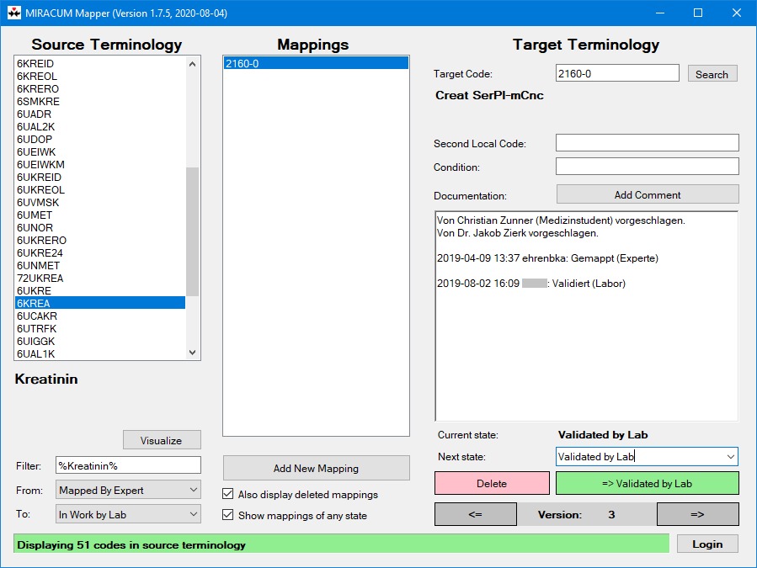
Notes:
On the left side, the program displays a list of the local codes to be mapped. You could also call it a TODO list. The list can be manipulated using the filter settings in the lower left part. For examples, it is also possible to search for specific local codes or terms. New mappings can be created in the center part of the window. Notice that there can be multiple mappings for a single local code. The actual mapping is shown and entered on the right side of the window. When the user enters a LOINC code, the code is automatically checked if it’s valid. As collaboration was an important aspect to us, we integrated a documentation field that enables users to comment on mappings or to make notes. The documentation is also automatically updated, when the user finally saves the mapping in the lower right corner. Notice that, besides saving the mapping, a mapping can also be deleted. You may have noticed that the mapping in the screenshot is in the state “Validated by Lab”, and you may have guessed that there are other states as well. And this brings me to the state machine. (1:12)

Slide 8
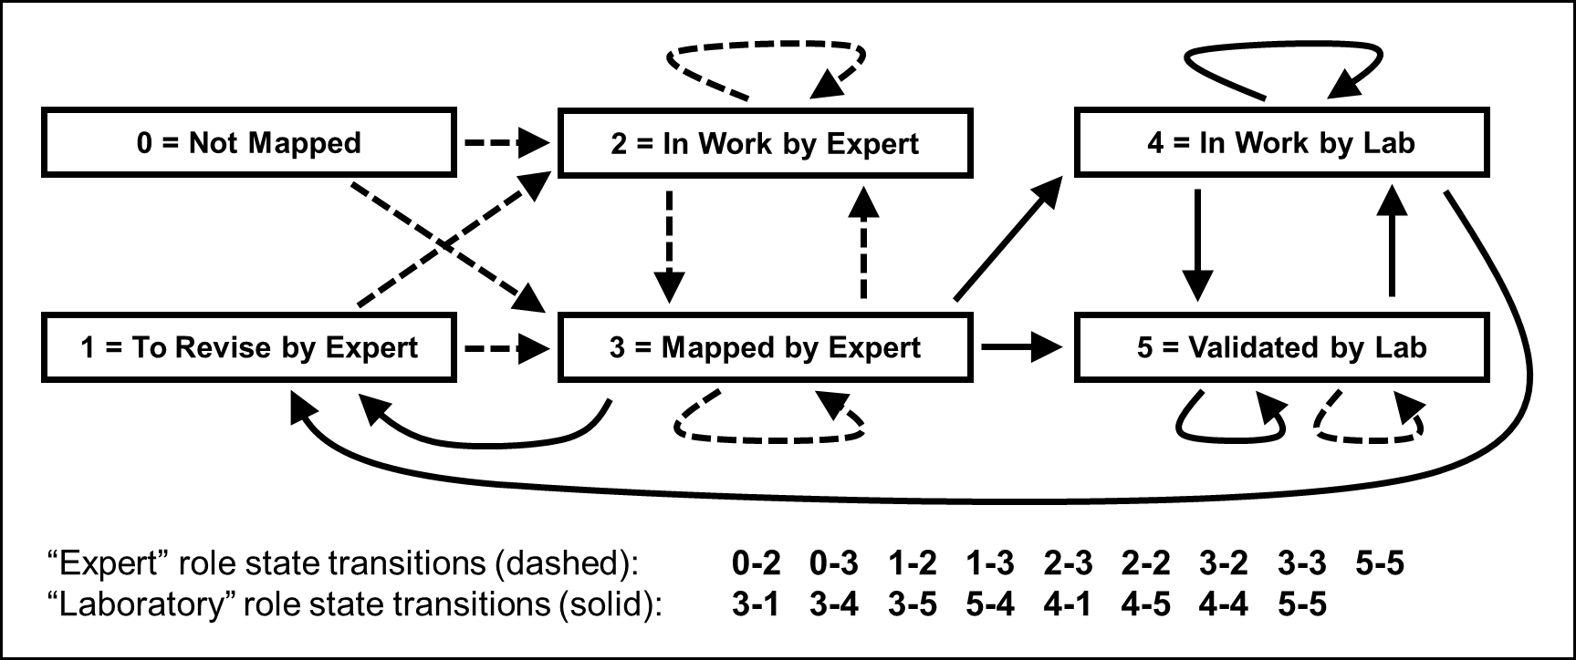
Methods: State Machine
Notes:
Basically, the state machine specifies the program’s internal behavior. The mappings, that the users create are passed from state to state. In our LOINC mapping, there are 6 states, enumerated from 0 to 5, as depicted by the 6 rectangular boxes. As shown on the left, the whole process typically starts with state 0, which is „Not mapped“. The best state a mapping can achieve is state 5, which is „Validated by Lab“. And this is what our project is all about: we want the laboratory staff to finally approve and validate the mappings. Besides the laboratory users, there are also experts, for whom the states 2 and 3 in the center are for. The arrows between the boxes depict the possible transitions between the states. As there are 2 types of user groups, namely „expert“ and „laboratory“ users, there are 2 types of arrows, which are drawn dashed and solid in the illustration. – Notice in the lower part that the whole state machine can be described using lists of transitions. For example, the first entry of the experts’ role „0 dash 2“ indicates that there is a transition from state 0 to state 2. (01:25)

Slide 9
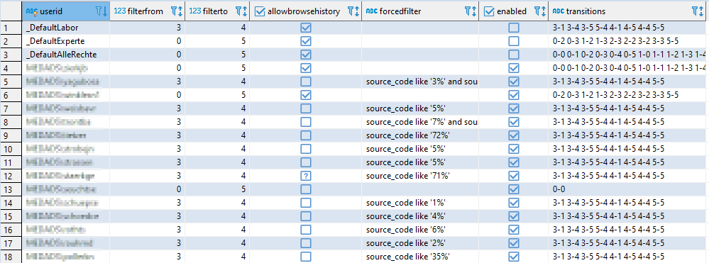
Results: User & Workflow Configuration
Notes:
If we have a brief look at the MIRACUM Mapper‘s database, you can see on the right column that these transition lists are used for each user to model how the program passes a mapping from one state into another. (0:15)

Slide 10
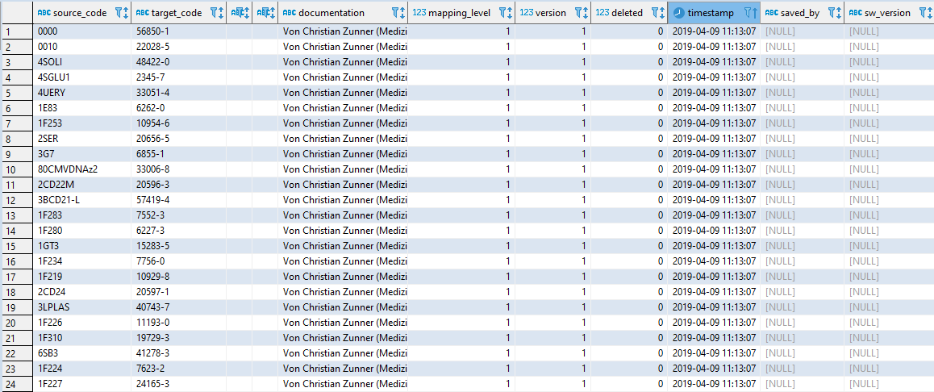
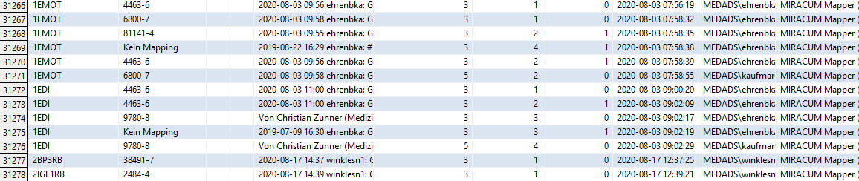
Results: Versioned Mappings
Notes:
Here you can see the first entries of the main mapping table of the program. Notice that we imported the old mappings from 2013 using state 1, as shown in the screenshot. Now after the program has been used for a while, the table has grown considerably and contains more than 31,000 records. As you can see, the new entries now use the higher mapping states. (0:25)

Slide 11
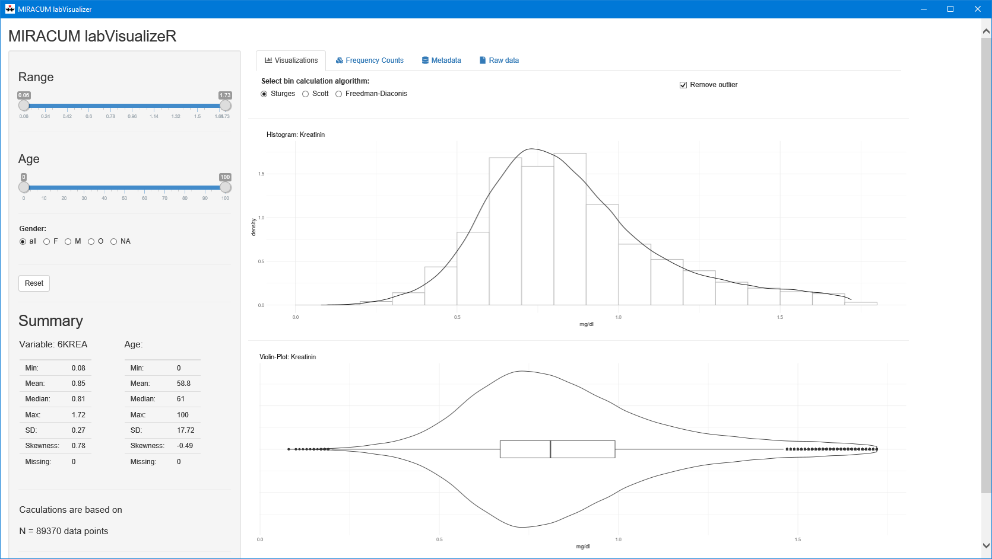
Methods
Notes:
After the rollout of the mapping application, we noticed that it would be helpful for users to be able to review additional information about local codes. As this is a requirement specific to the LOINC mapping effort, we decided to develop another application which we called the MIRACUM LabVisualizeR. Our goal was to provide quick access to additional information available in the original laboratory system, including metadata, anonymized sample patient data, but also computed statistics. As such, it displays histograms, violin plots, and summaries for the currently selected local laboratory code. (0:43)

Slide 12
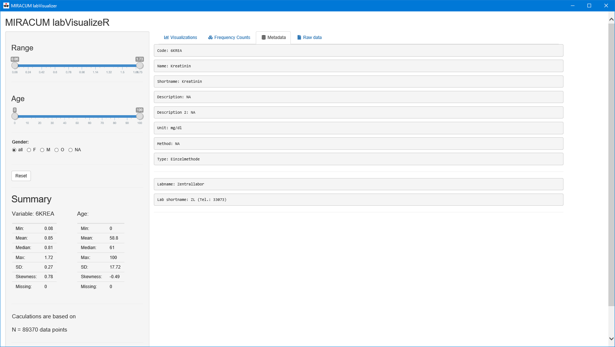
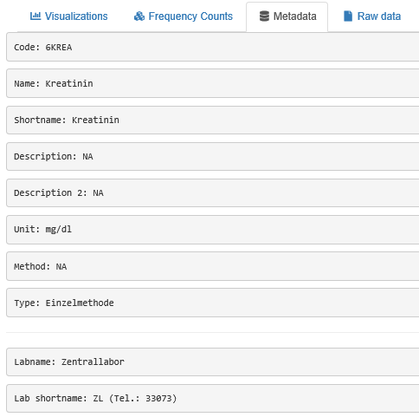
Methods
Notes:
The program can also be used to display simple metadata about lab codes, which helps the user in finding the correct mapping to LOINC. (0:10)

Slide 13
Results: Mapping
Both applications were used at UHE to map 9,970 local lab codes to LOINC
Took 6 months working full-time for the mapping expert (Katharina Ehrenberg)
Validation by labs is ongoing: 5,721 codes validated as of July 16, 2020
Notes:
So much for the technical aspects. Let me now briefly report on the actual results from using the tools. – After having imported the old 2013 mappings, both programs were used by a dedicated expert, Katharina Ehrenberg, in an epic effort for the mapping of nearly 10,000 local codes to LOINC. This to took Katharina about six months working full-time. The validation of the mappings by the laboratories is still ongoing. At the moment, about 6,000 mappings are validated. (0:30)

Slide 14
Discussion & Outlook
Collaboration (including the validation) was an important aspect => not supported in RELMA [5]
Preparatory tests to support the mapping with our semi-automatic matching approach (from ADOPT BBMRI-ERIC [6]) were not satisfactory
Maximum effort: resource-intensive research for the mapping experts
Notes:
As already mentioned a couple of times now, the collaborative aspect was very important for us. The previous mapping from 2013, which was created with RELMA, was pretty in good in terms of the actual mappings results. However, it was basically a one-off thing because at that time we failed to establish a sustainable service in our hospital, where future codes could be mapped. – To the best of our knowledge, RELMA does not support collaborative mapping workflows. That‘s why we came up with the implementation that I have just presented. On the other hand, RELMA contains features that are very appealing, for example the automatic suggestion of mappings. We tried to replicate this functionality in part by using a semi-automatic mapping approach that we developed within the ADOPT project. However, initial results were not fully satisfactory, which might be due to the high heterogeneity of data elements present in LOINC. – In the end, we suspected that most of the mapping work consists of researching content, and not in selecting the “best” match. But maybe the LOINC mapping that UHE is creating right now will be a valuable training dataset for machine learning-based approaches in the future. (1:20)

Slide 15
Discussion & Outlook
Ongoing in-depth comparison between the old and the new LOINC mapping
Preliminary results (comparison with lab-validated mappings): Zunner (2013 mapping): 75%, Ehrenberg: 88% correct
Roll-out to other MIRACUM sites
Both programs are open source
Notes:
What we are currently working on is a detailed comparison between the old and the new mapping. I don't want to give too much away yet, but I am happy to say that the new mapping is better by 13% compared to the old one. – The programs were rolled-out to the other MIRACUM sites as part of one of the project’s deliverables, and the other sites are now considering using the tools for their local LOINC mappings. Finally, I’m excited to let you know that both tools are open source. You can find the links to the source code in the abstract. (0:35)

Slide 16
References
[1] G. Hripcsak, J.D. Duke, N.H. Shah, C.G. Reich, and V. Huser, Observational Health Data Sciences and Informatics (OHDSI): Opportunities for Observational Researchers, Stud. Health Technol. Inform. (2015). doi:10.3233/978-1-61499-564-7-574.
[2] A.J. McMurry, S.N. Murphy, D. MacFadden, G.M. Weber, W.W. Simons, J. Orechia, J. Bickel, N. Wattanasin, C. Gilbert, P. Trevvett, S.E. Churchill, and I.S. Kohane, SHRINE: Enabling Nationally Scalable Multi-Site Disease Studies, PloS One. 8 (2013) e55811. doi:10.1371/journal.pone.0055811.
[3] F.S. Collins, K.L. Hudson, J.P. Briggs, and M.S. Lauer, PCORnet: Turning a Dream Into Reality, J. Am. Med. Inform. Assoc. 21 (2014) 576–577. doi:10.1136/amiajnl-2014-002864.
[4] C. Zunner, T. Bürkle, H.-U. Prokosch, and T. Ganslandt, Mapping Local Laboratory Interface Terms to LOINC at a German University Hospital Using RELMA V.5: A Semi-automated Approach, J. Am. Med. Inform. Assoc. 20 (2013) 293–297. doi:10.1136/amiajnl-2012-001063.
[5] D.J. Vreeman, J. Hook, and B.E. Dixon, Learning from the Crowd While Mapping to LOINC., J. Am. Med. Inform. Assoc. JAMIA. 22 (2015) 1205–1211. doi:10.1093/jamia/ocv098.
[6] S. Mate, M. Kampf, W. Rödle, S. Kraus, R. Proynova, K. Silander, L. Ebert, M. Lablans, C. Schüttler, C. Knell, N. Eklund, M. Hummel, P. Holub, and H.-U. Prokosch, Pan-European Data Harmonization for Biobanks in ADOPT BBMRI-ERIC, Appl. Clin. Inform. 10 (2019) 679–692. doi:10.1055/s-0039-1695793.
Thank you for your interest in our work. If you have any questions, please e-mail us:
sebastian.mate@uk-erlangen.de
Notes:
This brings me to the end of my presentation. If you have any questions related to our work, please contact us. We would be happy to hear from you! (0:15)

